Slide 1
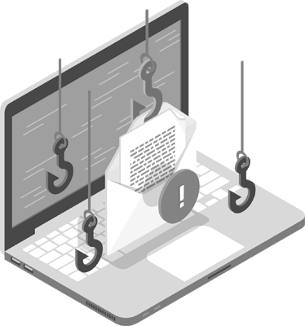
PHISHING EMAIL ANALYSIS
CASE STUDY:
MALICIOUS EMAIL RECEIVED DIRECTLY IN MY PERSONAL GMAIL
By: Elizabeth Sesebor
Date: 4th Dec. 2025
This Photo by Unknown Author is licensed under CC BY-SA-NC

Slide 2
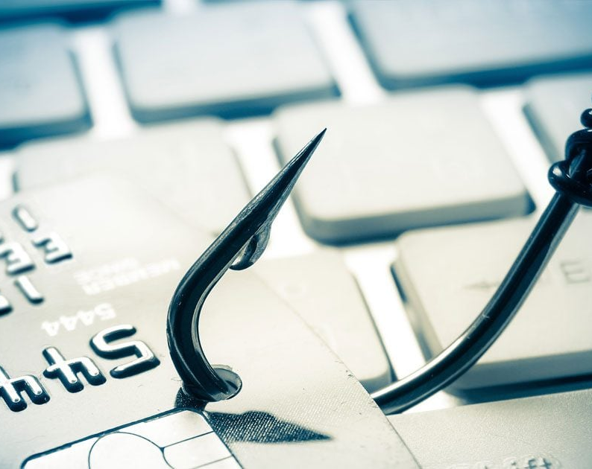
Content
Understanding phishing in organizations
Spotting a spoofed email
Analyzing suspicious urlS
Investigating email headers
Leveraging email security/filtering tools
Remediation strategies
conclusion

Slide 3
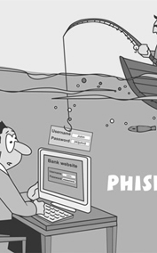
What is phishing?
Phishing is a type of social engineering attack in which an attacker impersonates a trusted entity to trick recipients into revealing sensitive information, clicking malicious links, or executing harmful attachments.
Why it matters to organizations:
Can lead to credential theft, financial loss, data breach, and malware infection.
Often targets employees via email, chat, or other communication platforms.

Slide 4
Spear Phishing: Targeted emails crafted for specific individuals or roles (uses personal details).
Whaling: High-value target attacks (CEO/CFO) — often financially motivated.
Business Email Compromise (BEC): Fraudulent requests that appear to come from executives or vendors asking for fund transfers or confidential info.
Clone Phishing: A legitimate email is copied, modified with malicious links/attachments, then resent.
Credential Harvesting: Fake login pages used to capture usernames/passwords.
Malicious Attachments: Emails carrying weaponized docs or executables.
Common types of phishing in organizations

Slide 5
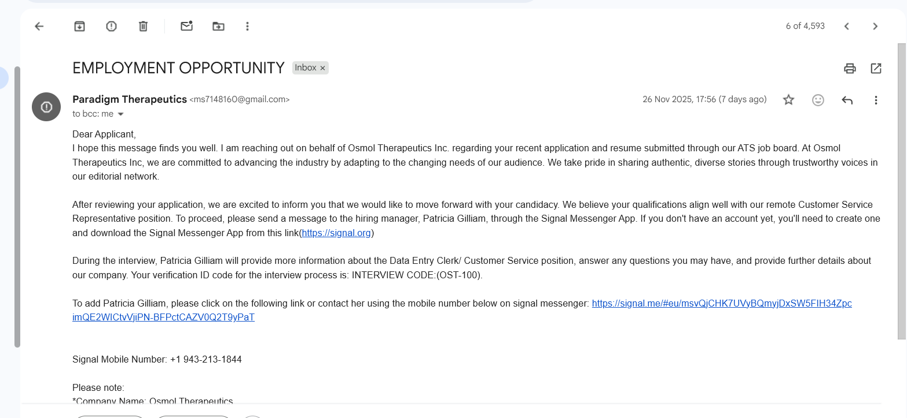
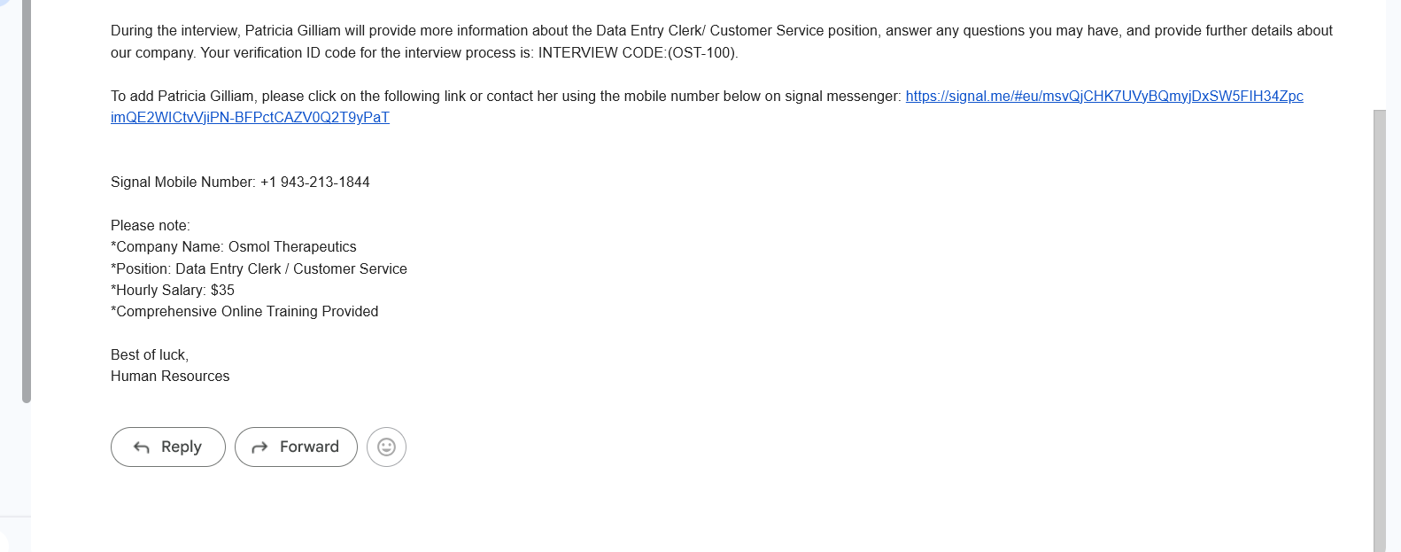
Spotting a spoofed email

Slide 6
The above screenshot shows a job-related email that was delivered to my personal inbox. The highlighted sections in red indicate several indicators that quickly identified the email as a spoofed and potentially malicious message.
The subject line was “Employment Opportunity”, and the sender claimed to represent a company named Paradigm Therapeutics. However, the sender's email address used a public domain (gmail.com) instead of an official corporate domain, which is a strong sign of impersonation. The message advertised an attractive pay rate of $35 per hour and listed an inconsistent job title (Data Entry Clerk / Customer Service Representative), which raised suspicion.
Using the S.T.O.P phishing detection model:
S – Suspicious: The sender did not use an official company domain.
T – Tells you to click a link: The email included a call-to-action link.
O – Offering something too good to be true: A high hourly wage was offered for an unclear role.
P – Pressures you to act fast: (Not observed in this case)
This email clearly triggered the first three indicators, making it highly suspicious.
To validate the legitimacy of the sender, I independently searched for Paradigm Therapeutics and contacted the company directly via their official website email address. The response received (shown below) confirmed that the email did not originate from them. The responder clearly used the legitimate domain (@paradigmtherapeutics.com), which verified that the email I received was fraudulent and that any link contained in the message was unsafe to click.

Slide 7
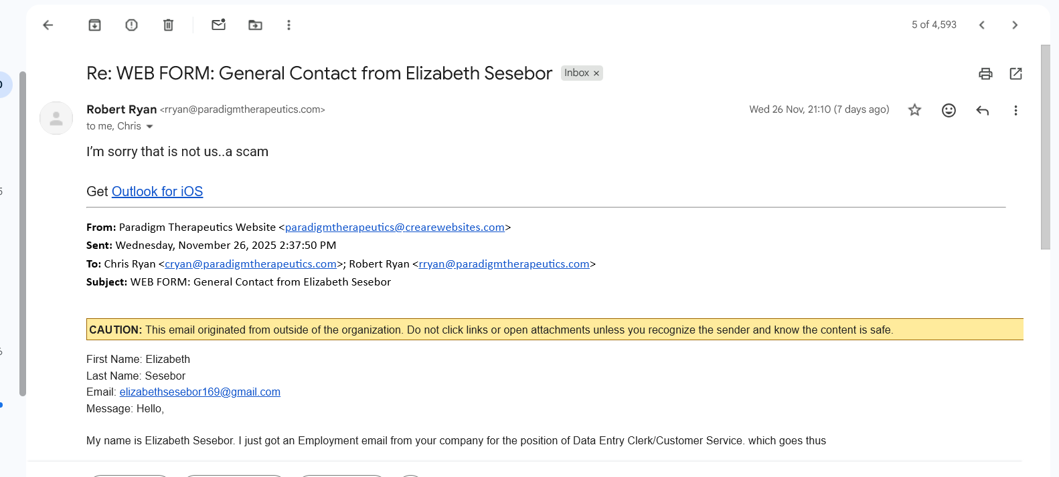
To further confirm the malicious nature of the email, I conducted a deeper investigation of the embedded link using the tool urlscan.io.
This analysis resolved the destination of the link, identified redirections, and revealed indicators commonly associated with phishing websites. The results provided further confirmation that the link was unsafe and associated with suspicious hosting behavior.
The screenshot below displays the output of the URL analysis.

Slide 8
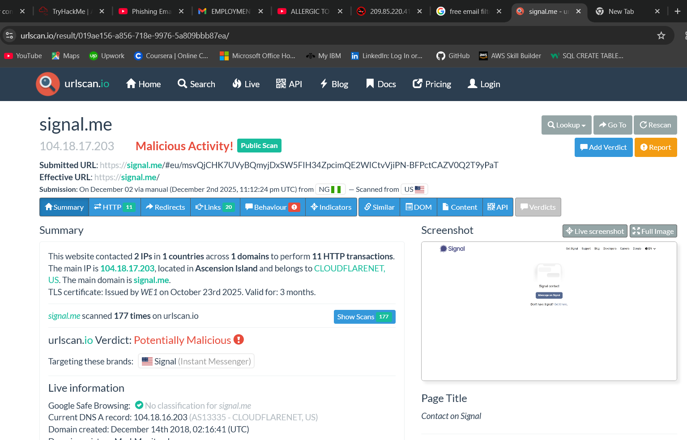
ANALYZING SUSPICIOUS URLs

Slide 9
INESTIGATING EMAIL HEADERS
The next phase of the investigation was email header analysis, which helps determine the true source of an email.
I exported the message as a file and opened it using Notepad to view the raw header data. A second tool, MxToolBox, was also used to assist with header parsing and interpretation.
The header analysis revealed details about:
Sending mail servers
Origin IP address
SPF, DKIM, and DMARC authentication results
Message routing path
Domain used
Mail transfer agents involved
All these elements are critical for forensically reviewing phishing emails and tracing their origin.

Slide 10
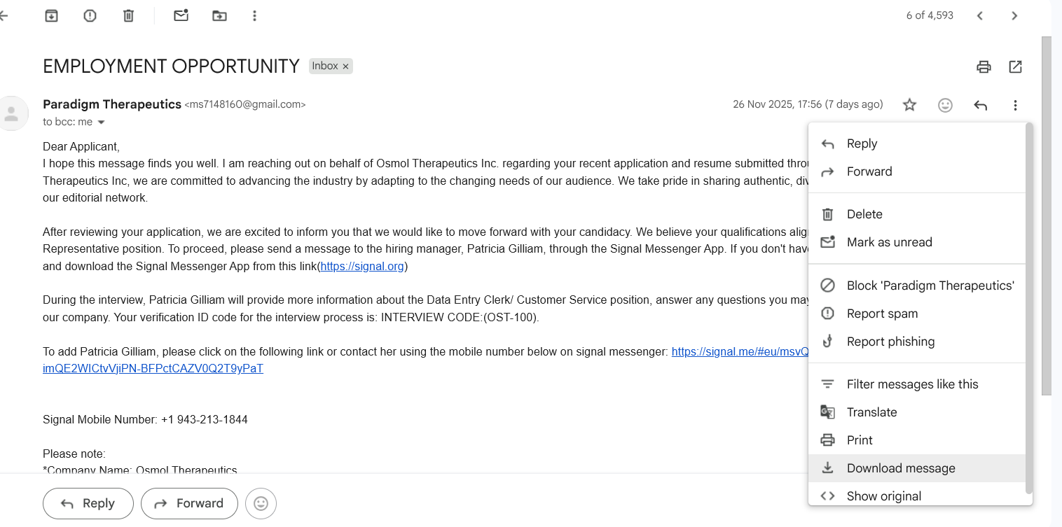
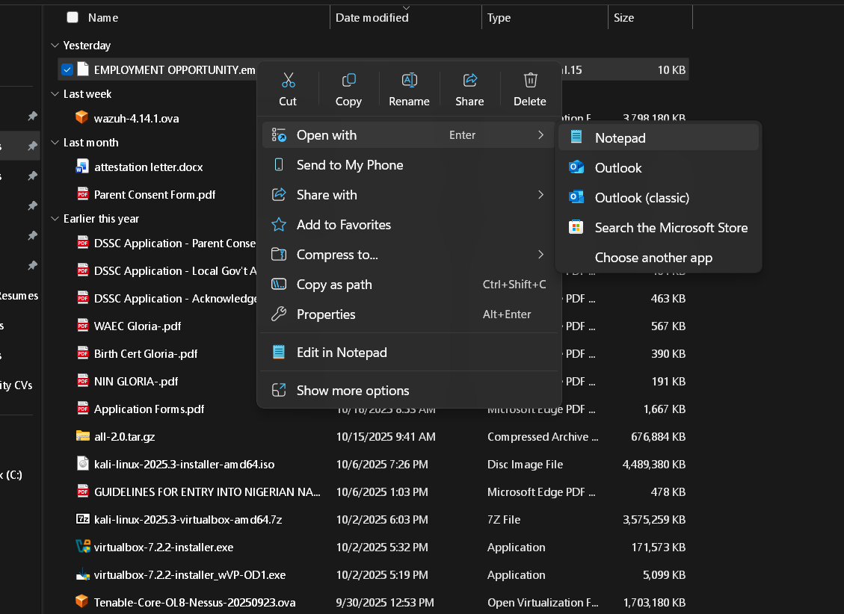

Slide 11
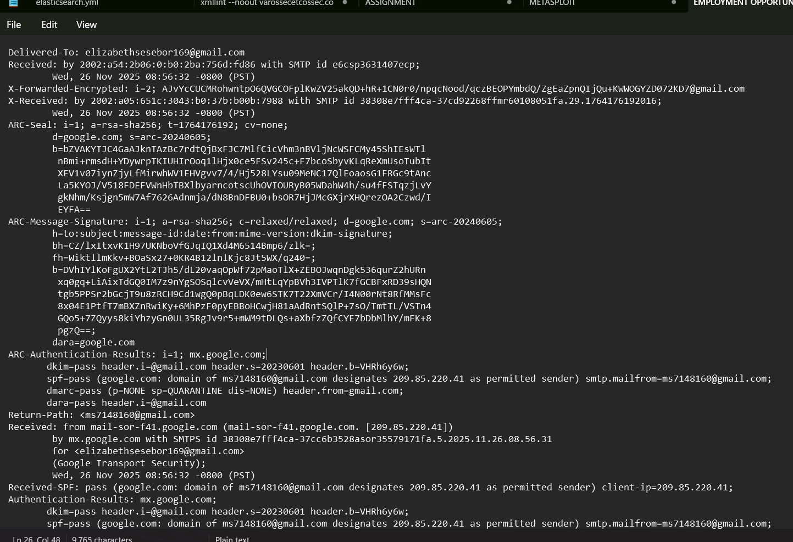

Slide 12
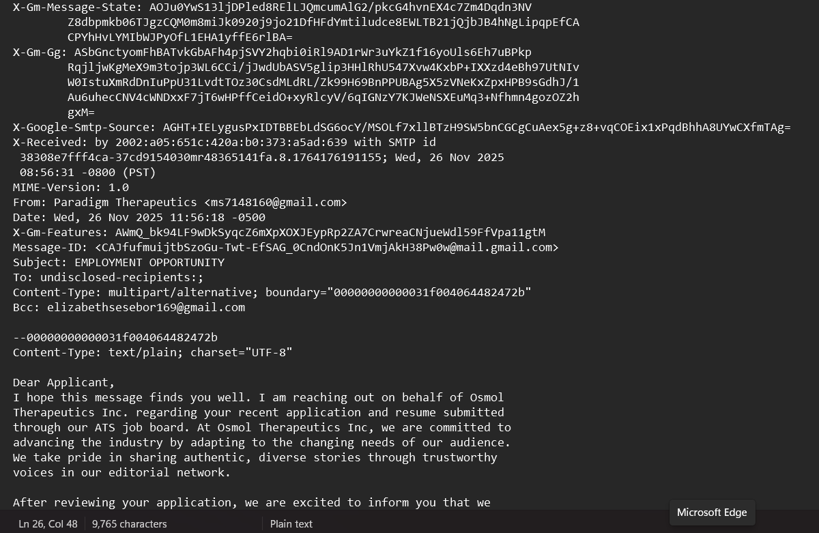

Slide 13
Under the Authentication Results, SPF, DKIM, and DMARC all passed, and the sending domain showed as gmail.com, which is a legitimate and trusted domain. However, deeper inspection revealed a major discrepancy:
From: “Paradigm Therapeutics” ms7148160@gmail.com
Return-Path: ms7148160@gmail.com
This indicates that although the message passed authentication checks, the sender did not originate from Paradigm Therapeutics but from a personal Gmail account—confirming impersonation.
The sending server was identified as mail-sor-f41, a legitimate Google mail server. Attackers frequently exploit trusted email service providers like Google to send phishing emails, allowing them to bypass initial filtering mechanisms and appear legitimate.
I also ran the sender IP address through AbuseIPDB,(diagram shown below) which showed:
The IP had been reported 265 times
Geographic location: India (ISP location, not necessarily the attacker)
This suggests historical abuse or suspicious activity associated with the IP.
Another red flag identified was:
The email was sent using “To: undisclosed recipients”, which is often used during bulk phishing campaigns to prevent recipients from seeing each other.

Slide 14
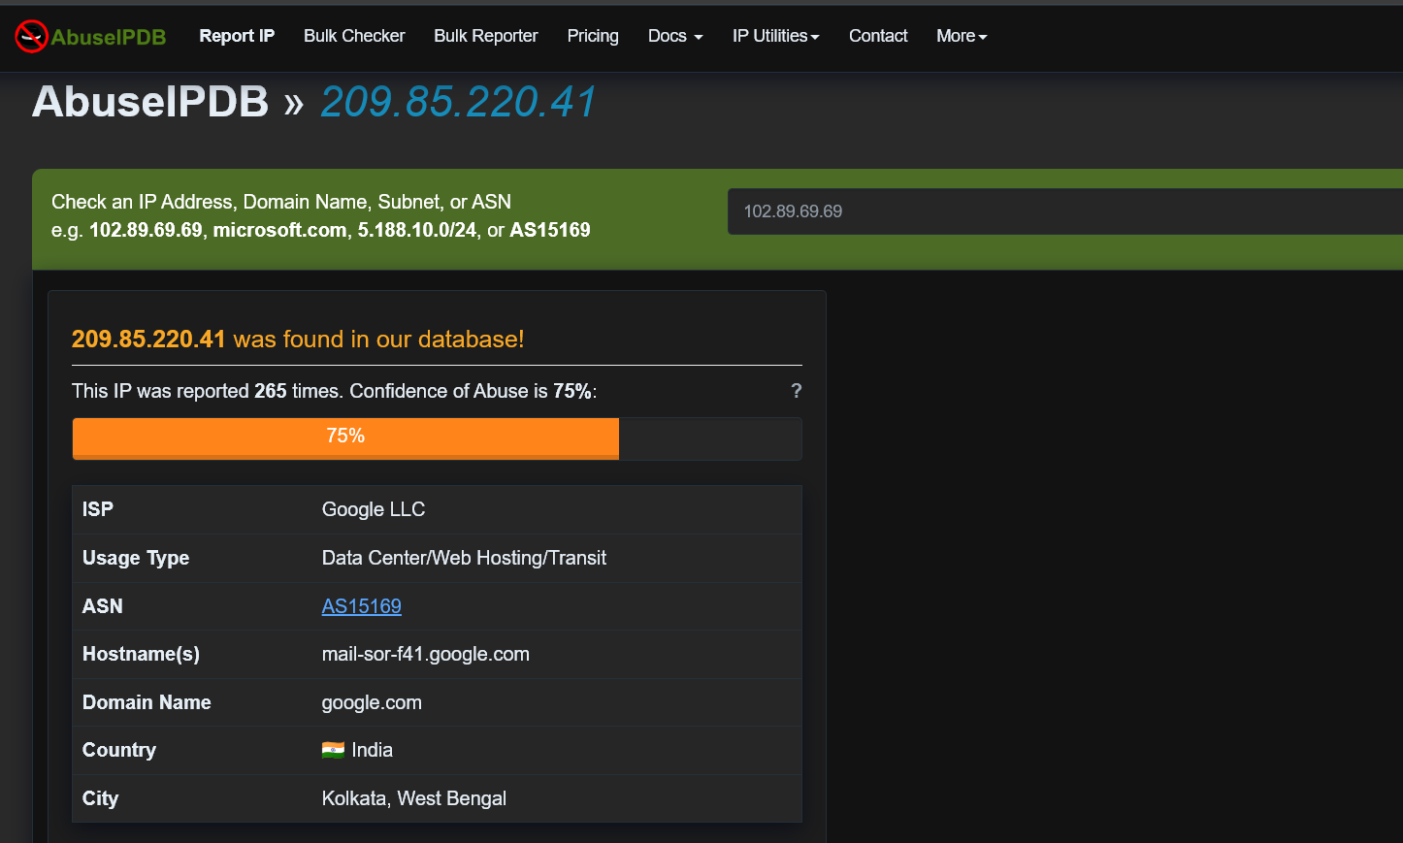

Slide 15
LEVERAGING EMAIL SECURITY/FILTERING TOOLS
I used a free automated phishing detection tool called Sublime Security to analyze the email.
The tool immediately flagged multiple anomalies including:
Sender impersonation
Header inconsistencies
Domain reputation issues
Suspicious message patterns
The results aligned with my manual analysis and confirmed that the email was malicious. The screenshots below show how the tool automatically detected these indicators.

Slide 16
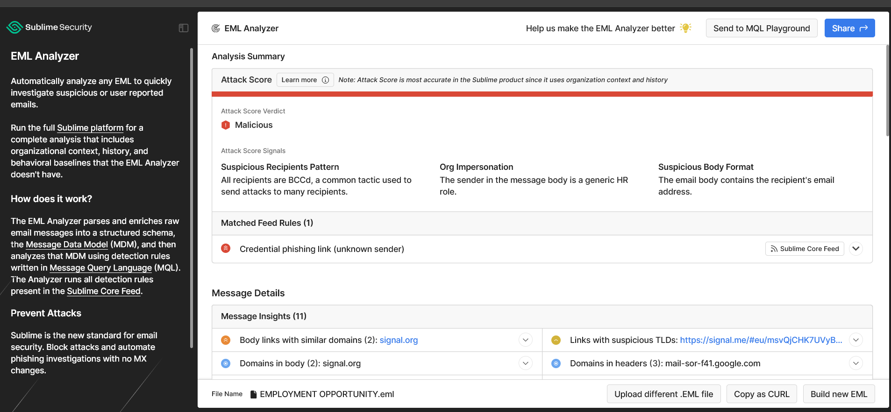

Slide 17
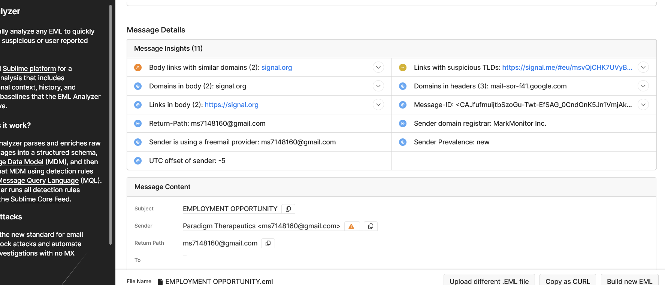

Slide 18
REMEDIATION STRATEGIES
Since this incident involved my personal email account, the immediate actions I took included:
Blocking the sender
Reporting the message as phishing/spam
Reviewing and tightening security settings
If this incident had occurred within an organization, the recommended actions would include:
Isolate the affected account(s) — force logout and revoke active sessions.
Reset credentials and enable MFA for compromised accounts.
Block malicious domains/IPs at the gateway and in web filters.
Quarantine or delete similar emails across mailboxes (search by Message-ID / subject / sender).
Scan affected endpoints for malware and indicators of compromise.
Follow-up actions:
Notify stakeholders and legal/compliance if PII was exposed.
Update blocklists and filtering rules.
Run a company-wide password reset if multiple accounts compromised.
Deliver a targeted awareness message to users about the specific phishing technique used.

Slide 19

CONCLUSION
This analysis confirms that phishing attacks today are sophisticated and often designed to appear legitimate. Although the email passed SPF, DKIM, and DMARC checks, deeper investigation exposed impersonation, suspicious routing, and malicious URLs. The attacker exploited a trusted email platform to bypass filters and increase delivery success. This case emphasizes that authentication alone does not guarantee legitimacy and highlights the importance of layered security controls, user awareness, and forensic analysis. Effective defense against phishing requires a combination of human vigilance, technical verification, and automated detection tools.

